Slide 1

The Future of App Development

Slide 2

Speaker
Gaspar Garcia
Head of AI Research, Vercel
Tech Lead, v0
Data Pipelines
Training + finetuning
Agent Development
Web Infrastructure

Slide 3

Speaker
Gaspar Garcia
Stanford Class 2016
BS, Computer Science Theory
MS, Computer Science AI

Slide 4

So what is v0?
Free for students → https://v0.app/students

Slide 5
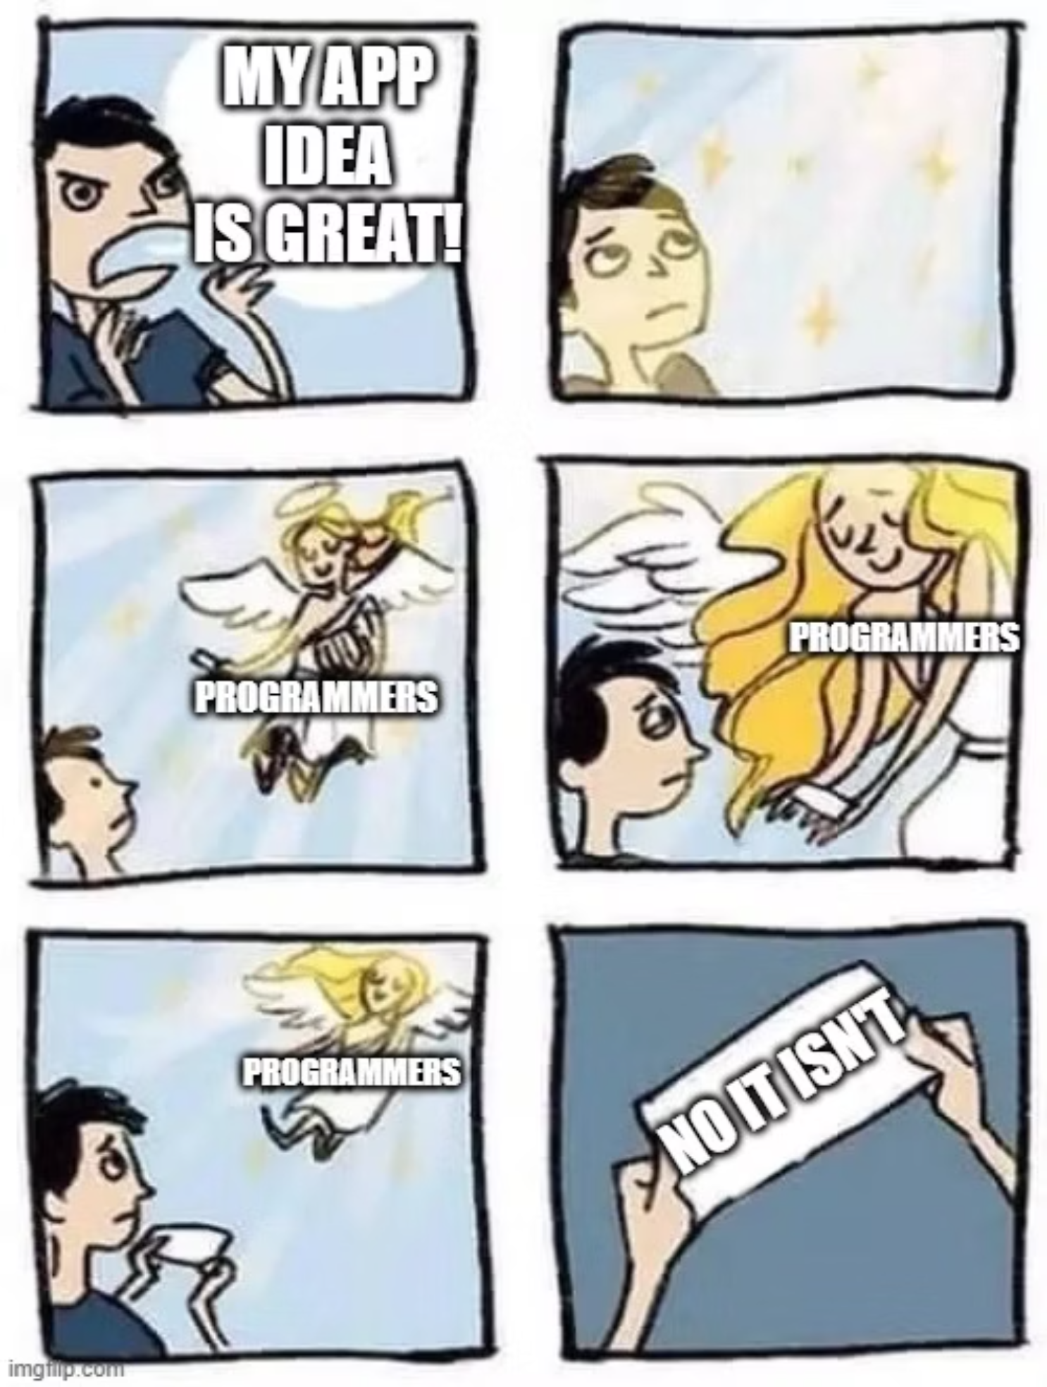

Slide 6
Most likely its not

Slide 7
Fail fast, fail often
Accelerate the learning moments of product development

Slide 8




From Idea to Production in Minutes
Natural Language Input
AI Processing
Describe your UI vision in plain English
Advanced models generate production-ready code
Live Preview
One-Click Deploy
Instantly see and iterate on your interface
Push to production without friction

Slide 9
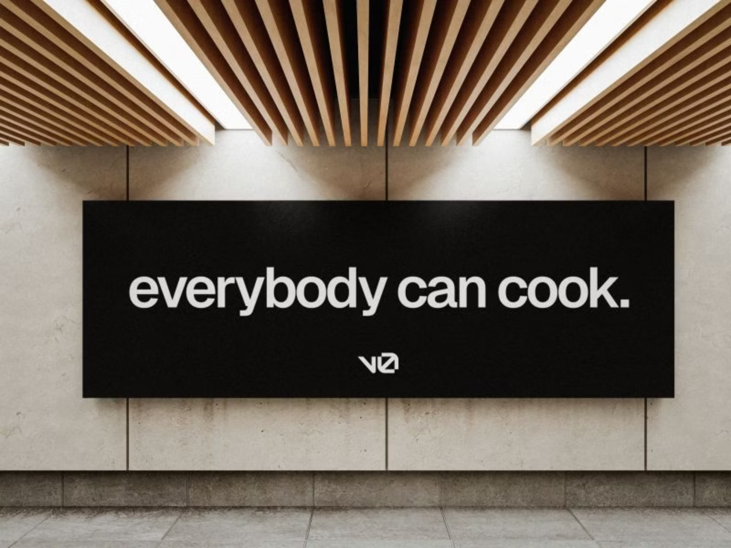

Slide 10
The Developer Landscape is Shifting
v0's rapid adoption demonstrates a fundamental change in how teams approach frontend development. The platform has resonated across company sizes—from startups moving at breakneck speed to enterprises modernizing legacy systems.
This isn't just about speed; it's about democratizing technical capability and enabling new forms of collaboration between engineering, design, and product teams.

Slide 11




Breaking Down Silos
AI-Powered Development Across All Personas
Product Managers
Designers
Engineers
Founders
Validate concepts quickly without waiting for engineering cycles. Transform PRDs into interactive prototypes for stakeholder review.
Bridge the gap between design tools and production code. See your vision implemented instantly with full responsiveness.
Focus on complex logic while AI handles boilerplate. Accelerate feature delivery and maintain quality standards.
Build and launch MVPs without large engineering teams. Iterate based on user feedback in real-time.

Slide 12
How its built

Slide 13
Inside v0's Engine
How Real-World Agent Systems Work
Intent Understanding
1
Natural language processing extracts structured requirements from conversational input, identifying components, layouts, interactions, and data flows.
2
Context Assembly
The system gathers relevant information: design system tokens, existing components, API schemas, and accessibility requirements.
Code Generation
3
Large language models generate production-quality React components with proper TypeScript types, responsive design, and best practices.
4
Validation & Testing
Automated checks ensure accessibility compliance, responsive behavior, and code quality before presenting to the user.
Human-in-the-Loop
5
Engineers review, refine, and provide feedback that trains the model for future generations.

Slide 14
Agents are Workflows

Slide 15
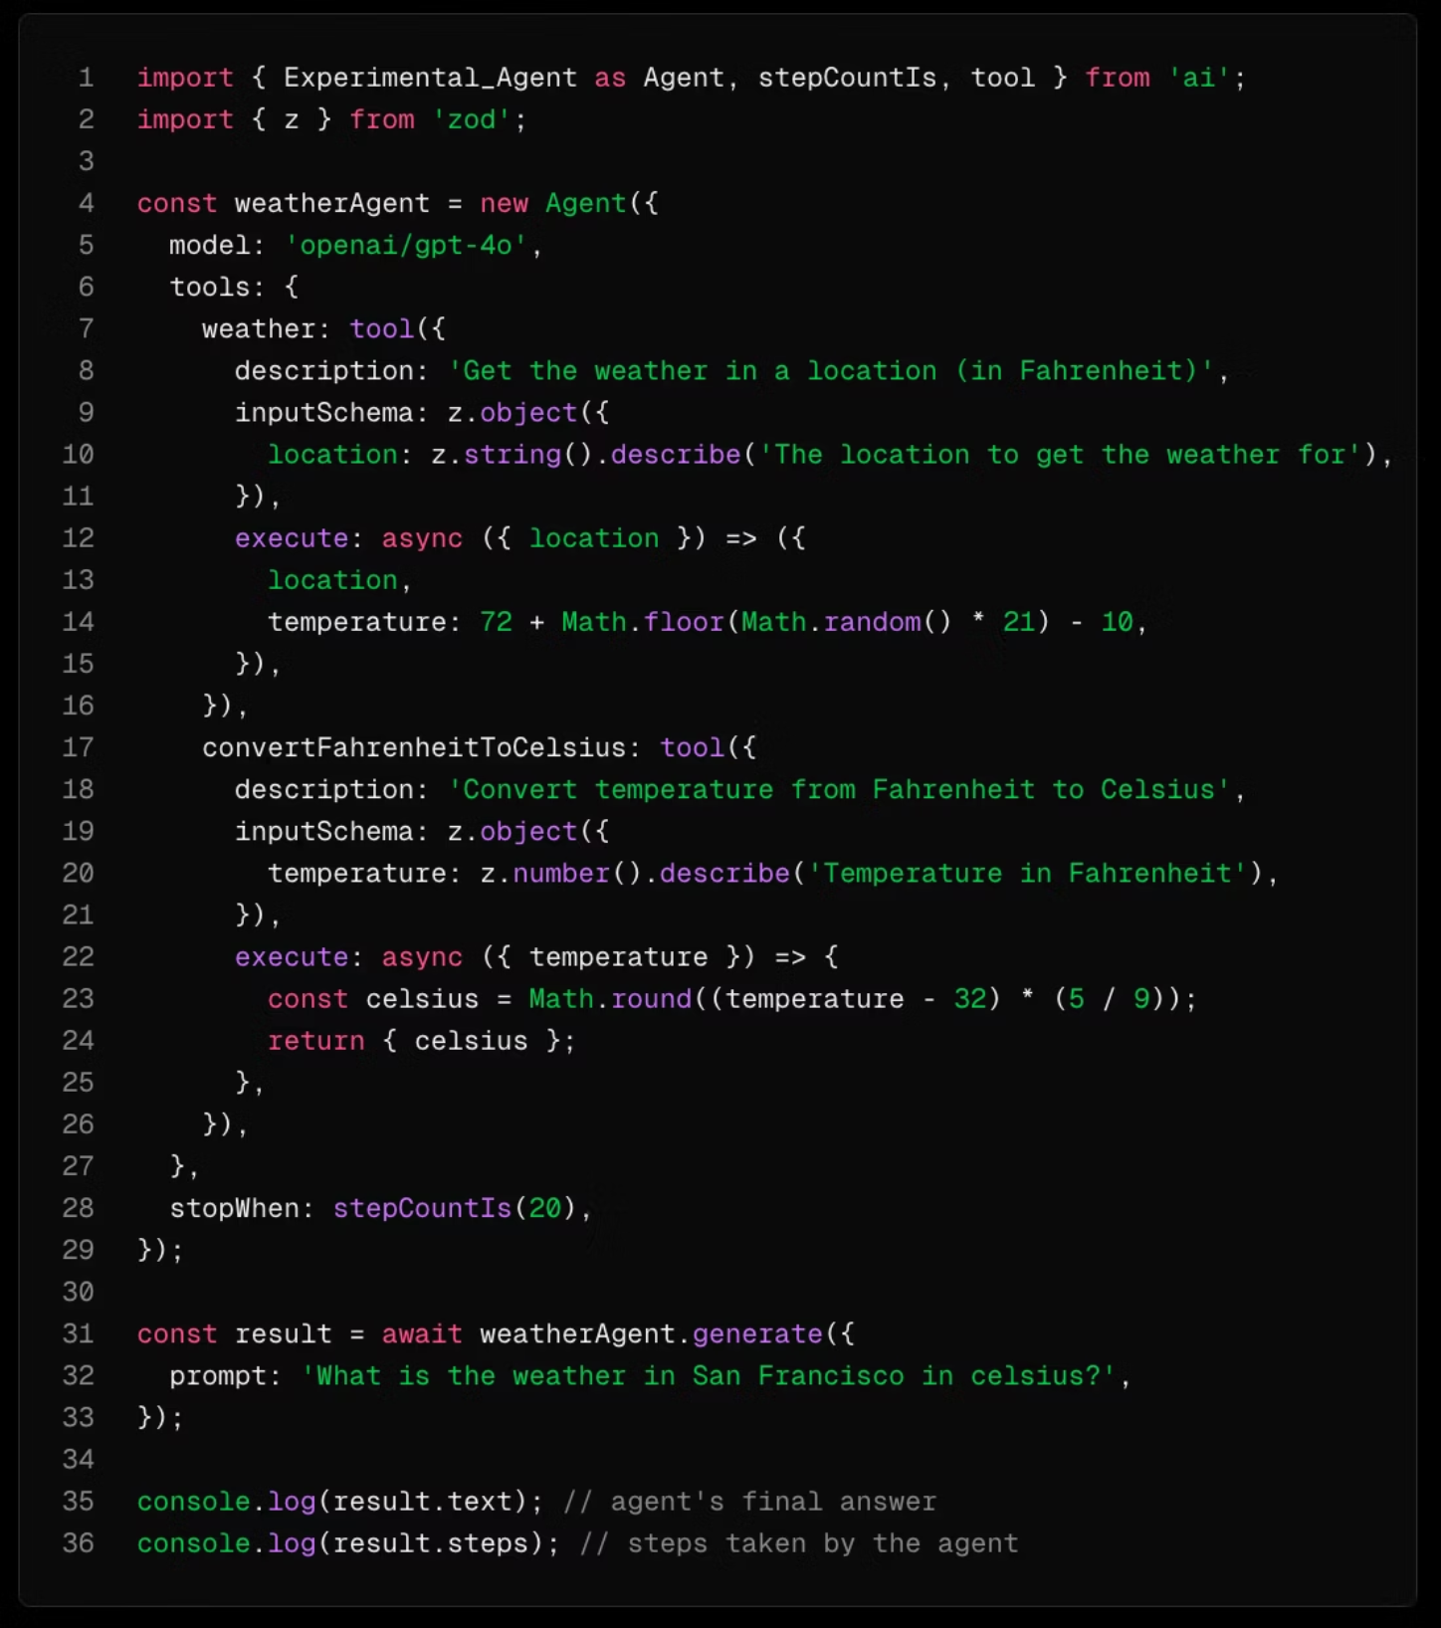
https://ai-sdk.dev/docs/agents/overview

Slide 16
But they're still probabilistic systems

Slide 17
Give them Frameworks

Slide 18

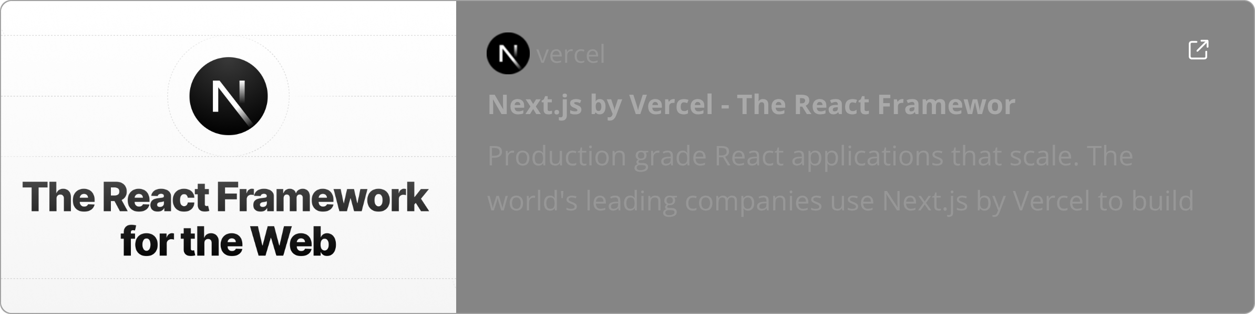

Slide 19
Corrections and Fine-Tuning

Slide 20
Key limitations
Model knowledge can quickly become outdated for topics that change fast.
Frontier model labs won't create custom pipelines just for emitting proper code for Next.js 16 web applications.

Slide 21
Stream Manipulation
The solution we created is a subsystem that lets us listen to and capture the LLM's output stream before it reaches the user
Sometimes, just adjusting the prompt isn't enough..

Slide 22
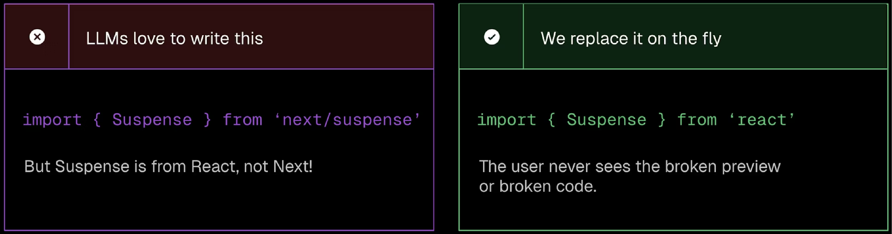
Stream Manipulation

Slide 23
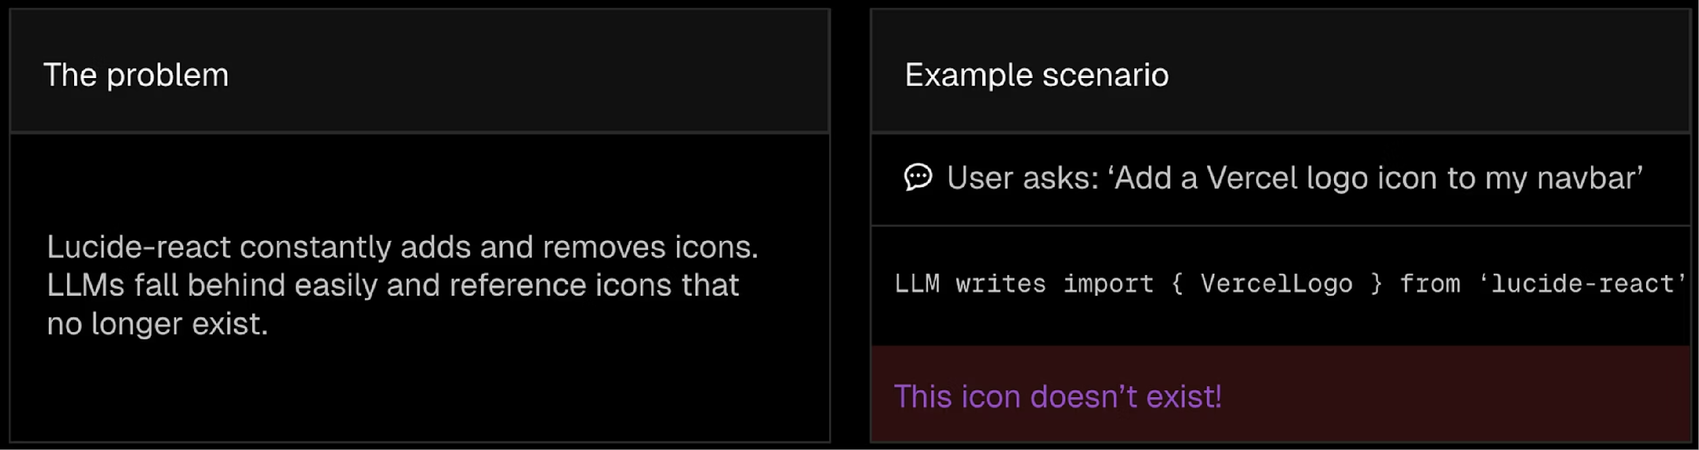
Stream Manipulation

Slide 24
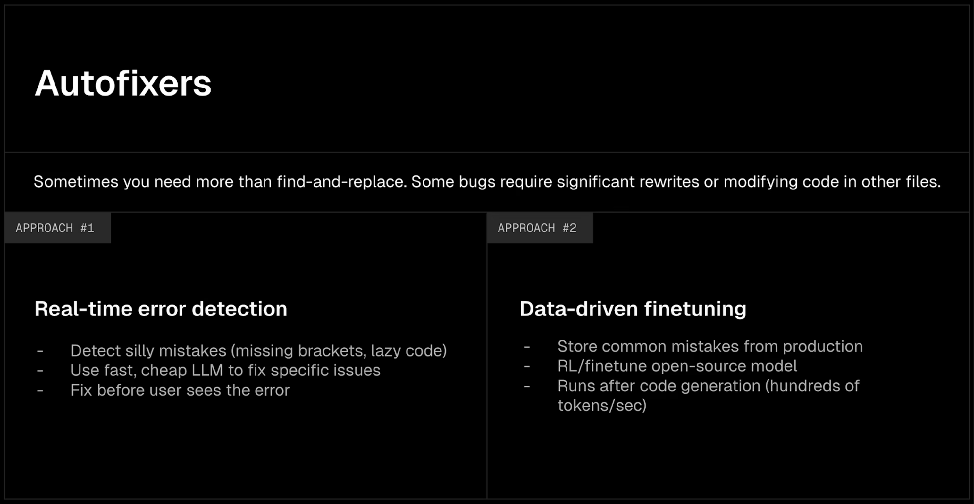
Training + Fine-Tuning

Slide 25
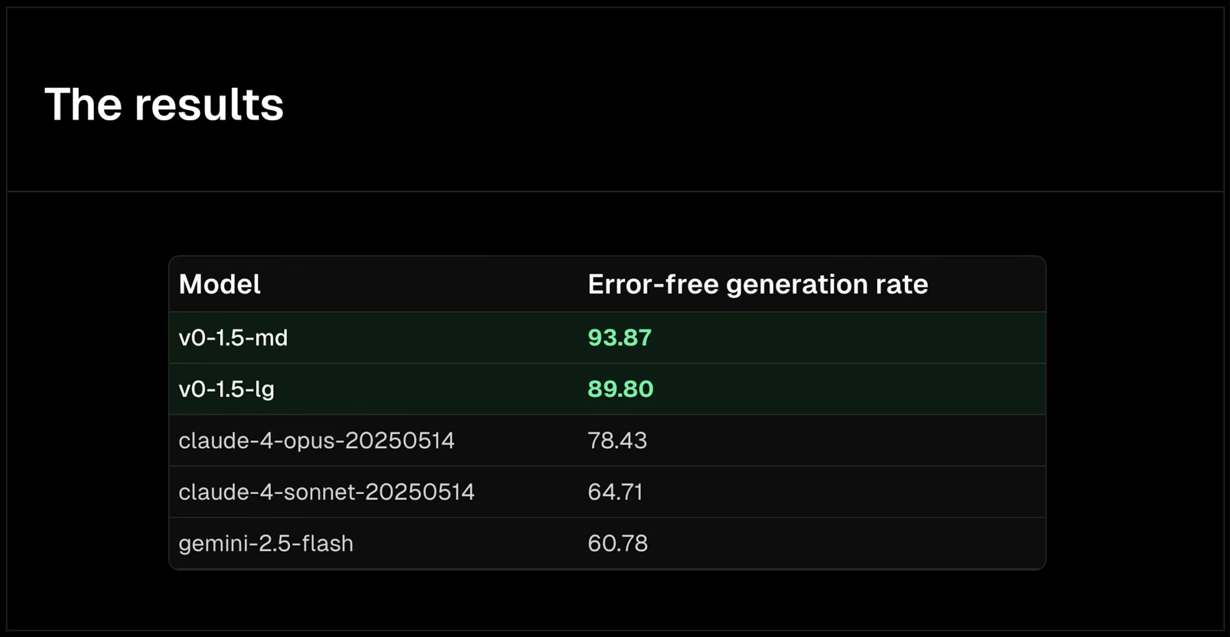
Training + Fine-Tuning
https://vercel.com/blog/v0-composite-model-family

Slide 26
The Broader AI Tooling Landscape
A Cambrian Explosion of AI Dev Tools
1
v0 exists within an ecosystem of specialized AI development tools, each targeting different aspects of the software lifecycle. From code completion to testing, deployment to monitoring—AI is transforming every stage.
Code Assistants
Vercel Agent, GitHub Copilot, Cursor, and similar tools for real-time code suggestions
The key differentiator? End-to-end workflows that handle entire features, not just autocomplete suggestions.
2
Frontend Builders
Visual development platforms
3
Testing & QA
Automated test generation and visual regression systems
4
DevOps Automation
AI-driven deployment, monitoring, and incident response

Slide 27
Real-World Impact
How Companies Are Adopting Agentic Workflows
Startup Velocity
Enterprise Modernization
Agency Efficiency
Early-stage companies ship MVPs in days instead of months.
Large organizations use v0 to prototype internal tools and customer-facing features before committing engineering resources.
Design agencies deliver interactive prototypes to clients within hours of kickoff meetings, accelerating the feedback loop.
Net-new products / features
Changes to existing features
Faster stakeholder alignment
5x more concepts per sprint
Reduced development waste
Higher client satisfaction

Slide 28
The Road Ahead
What's Next for AI-Driven Development

Slide 29
Thank you
https://x.com/gaspargarcia_

